Slide 1

S
COVID-19 vaccination
management system
Q
TR
T
E
R
D
E
U
G
By Gal Karasnty
& Elazar Fine

Slide 2

GENERAL INTRODUCTION
S
COVID-19 vaccination
management system
Q
The system oversees a vaccination operation in a city, managing data about its citizens, medical workers, and clinics and their vaccine supplies.
The purpose of the system is to facilitate vaccination appointments for citizens of varying risk groups, track the vaccination phase for each citizen, and make sure each clinic is adequately staffed and has enough vaccine supplies.
TR
T
E
R
D
E
U
By Gal Karastny
& Elazar Fine
G

Slide 3

GENERAL INTRODUCTION
USERS
S
GENERAL INTRODUCTION
GENERAL INTRODUCTION
Q
The system has three front ends:
One for citizens - to make appointments and track their status through an app and a website.
Second for city leaders / project managers - to overlook the operation and get relevant information to make informed logistical and managerial decisions.
Third for health care workers – to log vaccine administrations and to view their schedule.
The system oversees a vaccination operation in a city, managing data about its citizens, medical workers, and clinics and their vaccine supplies.
The purpose of the system is to facilitate vaccination appointments for citizens of varying risk groups, track the vaccination phase for each citizen, and make sure each clinic is adequately staffed and has enough vaccine supplies.
The system oversees a vaccination operation in a city, managing data about its citizens, medical workers, and clinics and their vaccine inventories.
The purpose of the system is to facilitate vaccination appointments for citizens of varying risk groups, track the vaccination phase for each citizen, and make sure each clinic is adequately staffed and has enough vaccines in its inventory.
The system oversees a vaccination operation in a city, managing data about its citizens, medical workers, and clinics and their vaccine inventories.
The purpose of the system is to facilitate vaccination appointments for citizens of varying risk groups, track the vaccination phase for each citizen, and make sure each clinic is adequately staffed and has enough vaccines in its inventory.
TR
T
E
R
D
E
U
G
G
G
G

Slide 4

USERS
USERS
ENTITIES
S
GENERAL
The system has three front ends
One for citizens - to make appointments and track their status through an app and a website
Second for health care workers - to receive daily schedules
Third for city leaders / project managers - to overlook the operation and get relevant information to make informed logistical and managerial decisions.
Q
The system has three front ends:
One for citizens - to make appointments and track their status through an app and a website.
Second for city leaders / project managers - to overlook the operation and get relevant information to make informed logistical and managerial decisions.
Third for health care workers – to log vaccine administrations and to view their schedule.
Vaccine (VaccineID, Name, Company)
Dose (DoseBarcode, *SupplyID)
Citizen (CitizenID, Fname, Lname, PhoneNum, RiskGroup, Age, Weight, Email, District, PhasesComplete)
HealthCareWorker (WorkerID, *ClinicID, FirstName, LastName, PhoneNum, LicenseNum, Seniority)
Clinic (ClinicID, ClinicName, PhoneNum, Email, Street, HouseNum, District)
Supply (SupplyID , *ClinicID, *VaccineID, ExpiryDate)
Appointment (AppointmentID, *CitizenID, Date, *ClinicID, *WorkerID)
The system oversees a vaccination operation in a city, managing data about its citizens, medical workers, and clinics and their vaccine inventories.
The purpose of the system is to facilitate vaccination appointments for citizens of varying risk groups, track the vaccination phase for each citizen, and make sure each clinic is adequately staffed and has enough vaccines in its inventory.
The system has a front end for users to make appointments and track their status through an app and a website, and one for city leaders / project managers to overlook the operation and get relevant information to make informed logistical and managerial decisions.
TR
T
E
R
D
E
U
U
U
G

Slide 5
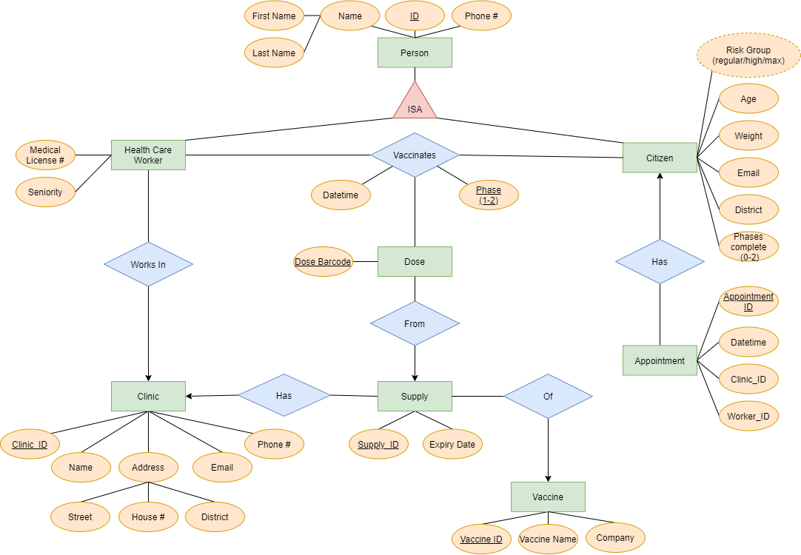
USERS
ENTITIES
GENERAL
S
ERD
The system has three front ends
One for citizens - to make appointments and track their status through an app and a website
Second for health care workers - to receive daily schedules
Third for city leaders / project managers - to overlook the operation and get relevant information to make informed logistical and managerial decisions.
Q
Vaccine (VaccineID, Name, Company)
Dose (DoseBarcode, *SupplyID)
Citizen (CitizenID, Fname, Lname, PhoneNum, RiskGroup, Age, Weight, Email, District, PhasesComplete)
HealthCareWorker (WorkerID, *ClinicID, FirstName, LastName, PhoneNum, LicenseNum, Seniority)
Clinic (ClinicID, ClinicName, PhoneNum, Email, Street, HouseNum, District)
Supply (SupplyID , *ClinicID, *VaccineID, ExpiryDate)
Appointment (AppointmentID, *CitizenID, Date, *ClinicID, *WorkerID)
The system oversees a vaccination operation in a city, managing data about its citizens, medical workers, and clinics and their vaccine inventories.
The purpose of the system is to facilitate vaccination appointments for citizens of varying risk groups, track the vaccination phase for each citizen, and make sure each clinic is adequately staffed and has enough vaccines in its inventory.
The system has a front end for users to make appointments and track their status through an app and a website, and one for city leaders / project managers to overlook the operation and get relevant information to make informed logistical and managerial decisions.
TR
T
E
R
D
E
U
U
G
G

Slide 6
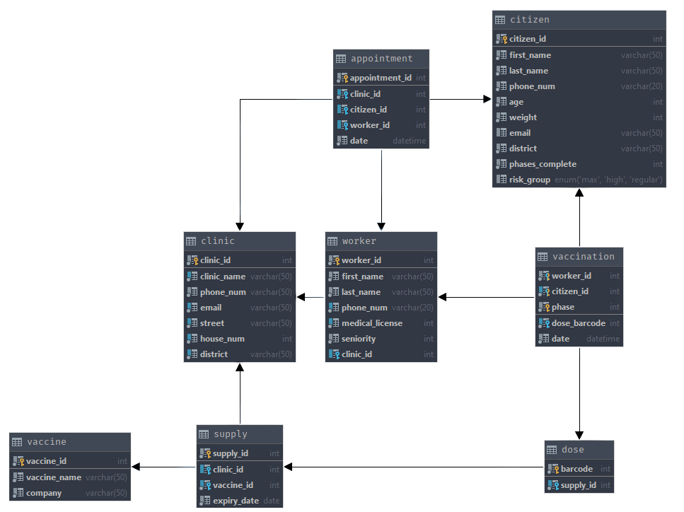
USERS
ENTITIES
ENTITIES
GENERAL
ERD
S
TABELS
The system has three front ends
One for citizens - to make appointments and track their status through an app and a website
Second for health care workers - to receive daily schedules
Third for city leaders / project managers - to overlook the operation and get relevant information to make informed logistical and managerial decisions.
Q
Vaccine (VaccineID, Name, Company)
Citizen (CitizenID, Fname, Lname, PhoneNum, RiskGroup, Age, Weight, Email, District)
HealthCareWorker (WorkerID, FirstName, LastName, PhoneNum, LicenseNum, Seniority)
Clinic (ClinicID, PhoneNum, Email, Street, HouseNum, District)
Inventory (InventoryID, VaccineID, Amount)
Appointment (AppointmentID, Date, ClinicID, WorkerID, Fullfield)
Vaccine (VaccineID, Name, Company)
Citizen (CitizenID, Fname, Lname, PhoneNum, RiskGroup, Age, Weight, Email, District)
HealthCareWorker (WorkerID, FirstName, LastName, PhoneNum, LicenseNum, Seniority)
Clinic (ClinicID, PhoneNum, Email, Street, HouseNum, District)
Inventory (InventoryID, VaccineID, Amount)
Appointment (AppointmentID, Date, ClinicID, WorkerID, Fullfield)
The system oversees a vaccination operation in a city, managing data about its citizens, medical workers, and clinics and their vaccine inventories.
The purpose of the system is to facilitate vaccination appointments for citizens of varying risk groups, track the vaccination phase for each citizen, and make sure each clinic is adequately staffed and has enough vaccines in its inventory.
The system has a front end for users to make appointments and track their status through an app and a website, and one for city leaders / project managers to overlook the operation and get relevant information to make informed logistical and managerial decisions.
TR
T
E
R
D
E
E
U
U
G
G

Slide 7
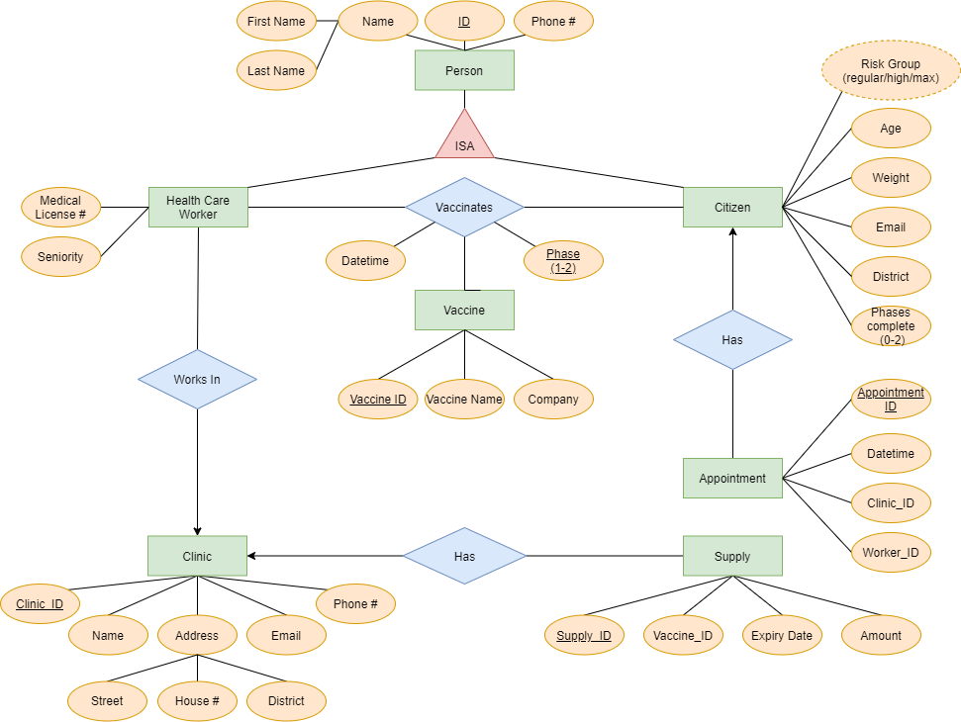
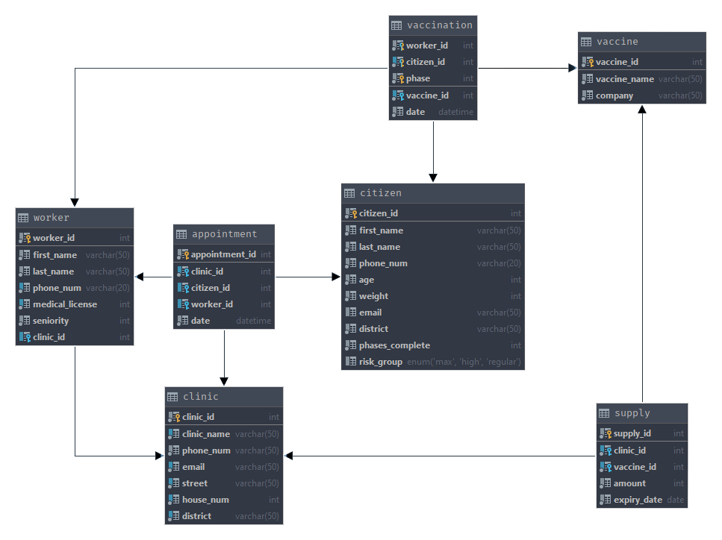
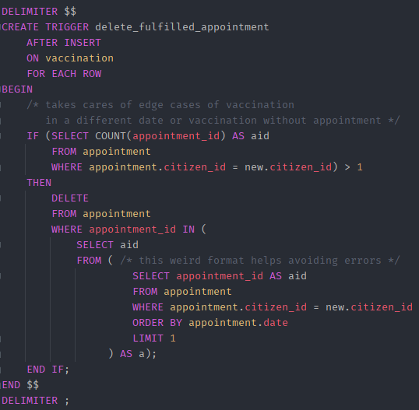
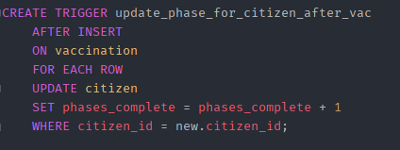
USERS
ENTITIES
ENTITIES
GENERAL
TABELS
ERD
S
TABELS
TRIGGERS
The system has three front ends
One for citizens - to make appointments and track their status through an app and a website
Second for health care workers - to receive daily schedules
Third for city leaders / project managers - to overlook the operation and get relevant information to make informed logistical and managerial decisions.
Q
Vaccine (VaccineID, Name, Company)
Citizen (CitizenID, Fname, Lname, PhoneNum, RiskGroup, Age, Weight, Email, District)
HealthCareWorker (WorkerID, FirstName, LastName, PhoneNum, LicenseNum, Seniority)
Clinic (ClinicID, PhoneNum, Email, Street, HouseNum, District)
Inventory (InventoryID, VaccineID, Amount)
Appointment (AppointmentID, Date, ClinicID, WorkerID, Fullfield)
Vaccine (VaccineID, Name, Company)
Citizen (CitizenID, Fname, Lname, PhoneNum, RiskGroup, Age, Weight, Email, District)
HealthCareWorker (WorkerID, FirstName, LastName, PhoneNum, LicenseNum, Seniority)
Clinic (ClinicID, PhoneNum, Email, Street, HouseNum, District)
Inventory (InventoryID, VaccineID, Amount)
Appointment (AppointmentID, Date, ClinicID, WorkerID, Fullfield)
The system oversees a vaccination operation in a city, managing data about its citizens, medical workers, and clinics and their vaccine inventories.
The purpose of the system is to facilitate vaccination appointments for citizens of varying risk groups, track the vaccination phase for each citizen, and make sure each clinic is adequately staffed and has enough vaccines in its inventory.
The system has a front end for users to make appointments and track their status through an app and a website, and one for city leaders / project managers to overlook the operation and get relevant information to make informed logistical and managerial decisions.
TR
T
T
E
R
D
E
E
U
U
G
G

Slide 8
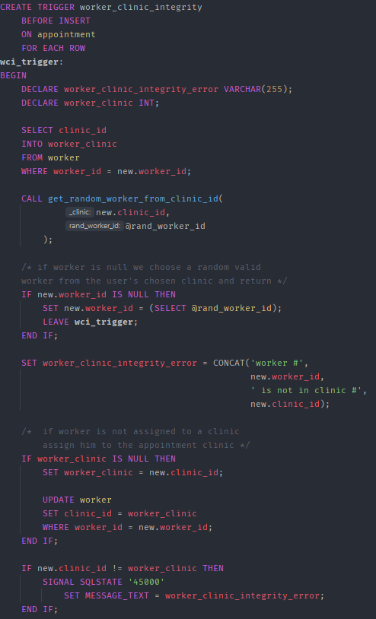
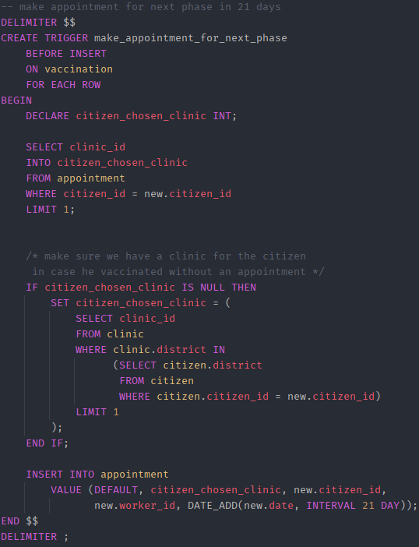
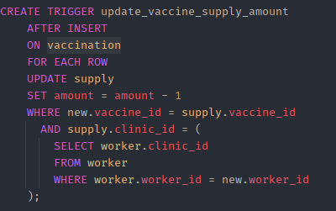
USERS
ENTITIES
ENTITIES
GENERAL
TABELS
S
ERD
TRIGGERS
The system has three front ends
One for citizens - to make appointments and track their status through an app and a website
Second for health care workers - to receive daily schedules
Third for city leaders / project managers - to overlook the operation and get relevant information to make informed logistical and managerial decisions.
Q
Vaccine (VaccineID, Name, Company)
Citizen (CitizenID, Fname, Lname, PhoneNum, RiskGroup, Age, Weight, Email, District)
HealthCareWorker (WorkerID, FirstName, LastName, PhoneNum, LicenseNum, Seniority)
Clinic (ClinicID, PhoneNum, Email, Street, HouseNum, District)
Inventory (InventoryID, VaccineID, Amount)
Appointment (AppointmentID, Date, ClinicID, WorkerID, Fullfield)
Vaccine (VaccineID, Name, Company)
Citizen (CitizenID, Fname, Lname, PhoneNum, RiskGroup, Age, Weight, Email, District)
HealthCareWorker (WorkerID, FirstName, LastName, PhoneNum, LicenseNum, Seniority)
Clinic (ClinicID, PhoneNum, Email, Street, HouseNum, District)
Inventory (InventoryID, VaccineID, Amount)
Appointment (AppointmentID, Date, ClinicID, WorkerID, Fullfield)
The system oversees a vaccination operation in a city, managing data about its citizens, medical workers, and clinics and their vaccine inventories.
The purpose of the system is to facilitate vaccination appointments for citizens of varying risk groups, track the vaccination phase for each citizen, and make sure each clinic is adequately staffed and has enough vaccines in its inventory.
The system has a front end for users to make appointments and track their status through an app and a website, and one for city leaders / project managers to overlook the operation and get relevant information to make informed logistical and managerial decisions.
TR
T
E
R
D
E
E
U
U
G
G

Slide 9
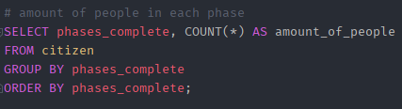
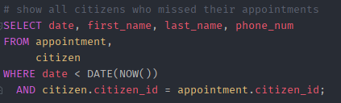
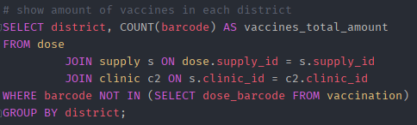
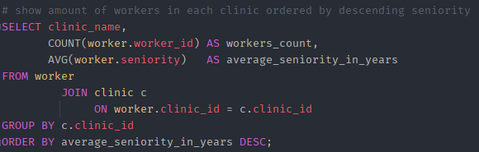
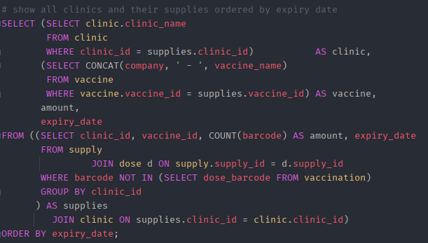
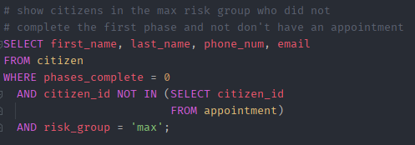
USERS
ENTITIES
ENTITIES
GENERAL
TABELS
S
ERD
TRIGGERS
QUERIES
The system has three front ends
One for citizens - to make appointments and track their status through an app and a website
Second for health care workers - to receive daily schedules
Third for city leaders / project managers - to overlook the operation and get relevant information to make informed logistical and managerial decisions.
Q
Vaccine (VaccineID, Name, Company)
Citizen (CitizenID, Fname, Lname, PhoneNum, RiskGroup, Age, Weight, Email, District)
HealthCareWorker (WorkerID, FirstName, LastName, PhoneNum, LicenseNum, Seniority)
Clinic (ClinicID, PhoneNum, Email, Street, HouseNum, District)
Inventory (InventoryID, VaccineID, Amount)
Appointment (AppointmentID, Date, ClinicID, WorkerID, Fullfield)
Vaccine (VaccineID, Name, Company)
Citizen (CitizenID, Fname, Lname, PhoneNum, RiskGroup, Age, Weight, Email, District)
HealthCareWorker (WorkerID, FirstName, LastName, PhoneNum, LicenseNum, Seniority)
Clinic (ClinicID, PhoneNum, Email, Street, HouseNum, District)
Inventory (InventoryID, VaccineID, Amount)
Appointment (AppointmentID, Date, ClinicID, WorkerID, Fullfield)
select queries
The system oversees a vaccination operation in a city, managing data about its citizens, medical workers, and clinics and their vaccine inventories.
The purpose of the system is to facilitate vaccination appointments for citizens of varying risk groups, track the vaccination phase for each citizen, and make sure each clinic is adequately staffed and has enough vaccines in its inventory.
The system has a front end for users to make appointments and track their status through an app and a website, and one for city leaders / project managers to overlook the operation and get relevant information to make informed logistical and managerial decisions.
TR
T
E
R
D
E
E
U
U
G
G

Slide 10
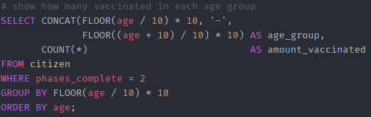
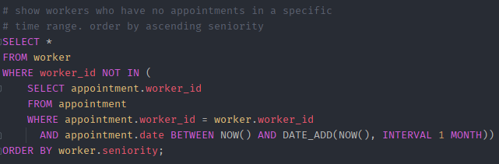
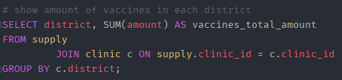
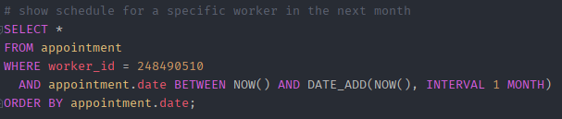
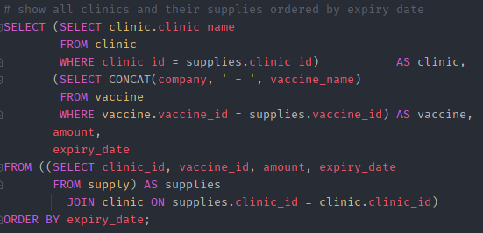
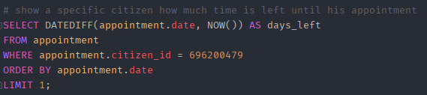
USERS
ENTITIES
ENTITIES
GENERAL
TABELS
S
ERD
TRIGGERS
QUERIES
The system has three front ends
One for citizens - to make appointments and track their status through an app and a website
Second for health care workers - to receive daily schedules
Third for city leaders / project managers - to overlook the operation and get relevant information to make informed logistical and managerial decisions.
Q
Vaccine (VaccineID, Name, Company)
Citizen (CitizenID, Fname, Lname, PhoneNum, RiskGroup, Age, Weight, Email, District)
HealthCareWorker (WorkerID, FirstName, LastName, PhoneNum, LicenseNum, Seniority)
Clinic (ClinicID, PhoneNum, Email, Street, HouseNum, District)
Inventory (InventoryID, VaccineID, Amount)
Appointment (AppointmentID, Date, ClinicID, WorkerID, Fullfield)
Vaccine (VaccineID, Name, Company)
Citizen (CitizenID, Fname, Lname, PhoneNum, RiskGroup, Age, Weight, Email, District)
HealthCareWorker (WorkerID, FirstName, LastName, PhoneNum, LicenseNum, Seniority)
Clinic (ClinicID, PhoneNum, Email, Street, HouseNum, District)
Inventory (InventoryID, VaccineID, Amount)
Appointment (AppointmentID, Date, ClinicID, WorkerID, Fullfield)
select queries
select queries
The system oversees a vaccination operation in a city, managing data about its citizens, medical workers, and clinics and their vaccine inventories.
The purpose of the system is to facilitate vaccination appointments for citizens of varying risk groups, track the vaccination phase for each citizen, and make sure each clinic is adequately staffed and has enough vaccines in its inventory.
The system has a front end for users to make appointments and track their status through an app and a website, and one for city leaders / project managers to overlook the operation and get relevant information to make informed logistical and managerial decisions.
select queries
TR
T
E
R
D
E
E
U
U
G
G

Slide 11
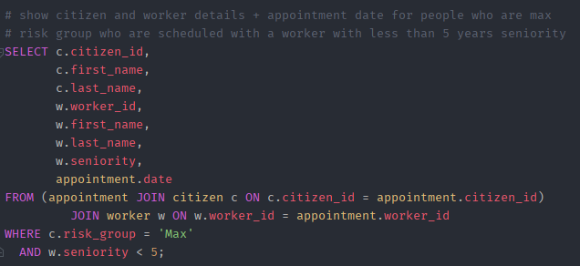
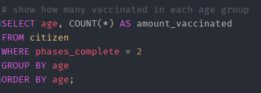
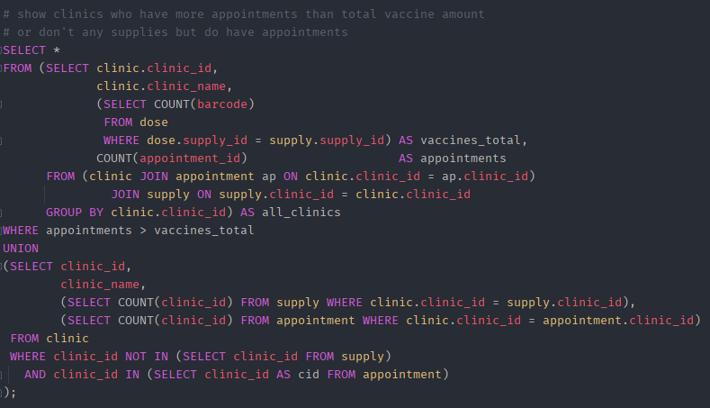
USERS
ENTITIES
ENTITIES
GENERAL
TABELS
S
ERD
TRIGGERS
QUERIES
The system has three front ends
One for citizens - to make appointments and track their status through an app and a website
Second for health care workers - to receive daily schedules
Third for city leaders / project managers - to overlook the operation and get relevant information to make informed logistical and managerial decisions.
Q
Vaccine (VaccineID, Name, Company)
Citizen (CitizenID, Fname, Lname, PhoneNum, RiskGroup, Age, Weight, Email, District)
HealthCareWorker (WorkerID, FirstName, LastName, PhoneNum, LicenseNum, Seniority)
Clinic (ClinicID, PhoneNum, Email, Street, HouseNum, District)
Inventory (InventoryID, VaccineID, Amount)
Appointment (AppointmentID, Date, ClinicID, WorkerID, Fullfield)
Vaccine (VaccineID, Name, Company)
Citizen (CitizenID, Fname, Lname, PhoneNum, RiskGroup, Age, Weight, Email, District)
HealthCareWorker (WorkerID, FirstName, LastName, PhoneNum, LicenseNum, Seniority)
Clinic (ClinicID, PhoneNum, Email, Street, HouseNum, District)
Inventory (InventoryID, VaccineID, Amount)
Appointment (AppointmentID, Date, ClinicID, WorkerID, Fullfield)
select queries
The system oversees a vaccination operation in a city, managing data about its citizens, medical workers, and clinics and their vaccine inventories.
The purpose of the system is to facilitate vaccination appointments for citizens of varying risk groups, track the vaccination phase for each citizen, and make sure each clinic is adequately staffed and has enough vaccines in its inventory.
The system has a front end for users to make appointments and track their status through an app and a website, and one for city leaders / project managers to overlook the operation and get relevant information to make informed logistical and managerial decisions.
select queries
select queries
select queries
TR
T
E
R
D
E
E
U
U
G
G

Slide 12
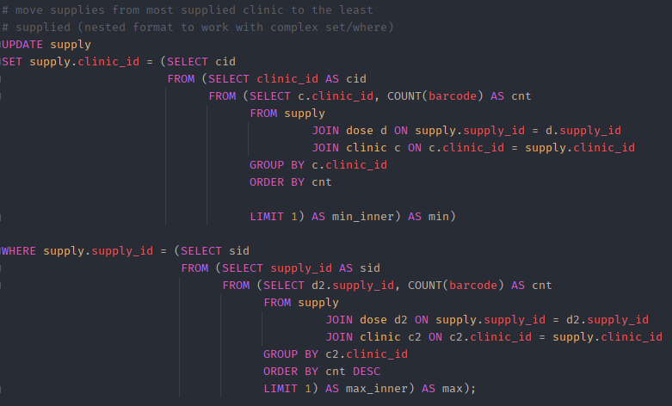
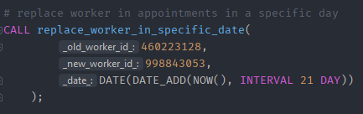
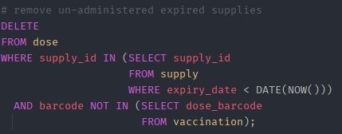
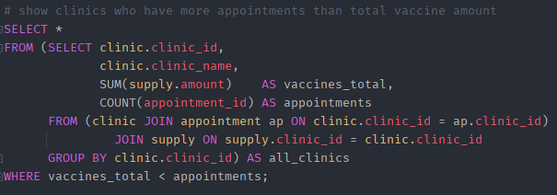
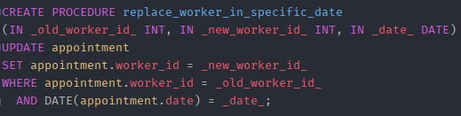
USERS
ENTITIES
ENTITIES
GENERAL
TABELS
S
ERD
TRIGGERS
QUERIES
The system has three front ends
One for citizens - to make appointments and track their status through an app and a website
Second for health care workers - to receive daily schedules
Third for city leaders / project managers - to overlook the operation and get relevant information to make informed logistical and managerial decisions.
Q
Vaccine (VaccineID, Name, Company)
Citizen (CitizenID, Fname, Lname, PhoneNum, RiskGroup, Age, Weight, Email, District)
HealthCareWorker (WorkerID, FirstName, LastName, PhoneNum, LicenseNum, Seniority)
Clinic (ClinicID, PhoneNum, Email, Street, HouseNum, District)
Inventory (InventoryID, VaccineID, Amount)
Appointment (AppointmentID, Date, ClinicID, WorkerID, Fullfield)
Vaccine (VaccineID, Name, Company)
Citizen (CitizenID, Fname, Lname, PhoneNum, RiskGroup, Age, Weight, Email, District)
HealthCareWorker (WorkerID, FirstName, LastName, PhoneNum, LicenseNum, Seniority)
Clinic (ClinicID, PhoneNum, Email, Street, HouseNum, District)
Inventory (InventoryID, VaccineID, Amount)
Appointment (AppointmentID, Date, ClinicID, WorkerID, Fullfield)
select queries
The system oversees a vaccination operation in a city, managing data about its citizens, medical workers, and clinics and their vaccine inventories.
The purpose of the system is to facilitate vaccination appointments for citizens of varying risk groups, track the vaccination phase for each citizen, and make sure each clinic is adequately staffed and has enough vaccines in its inventory.
The system has a front end for users to make appointments and track their status through an app and a website, and one for city leaders / project managers to overlook the operation and get relevant information to make informed logistical and managerial decisions.
select queries
select queries
Update/insert/delete
select queries
TR
T
E
R
D
E
E
U
U
G
G

Slide 13
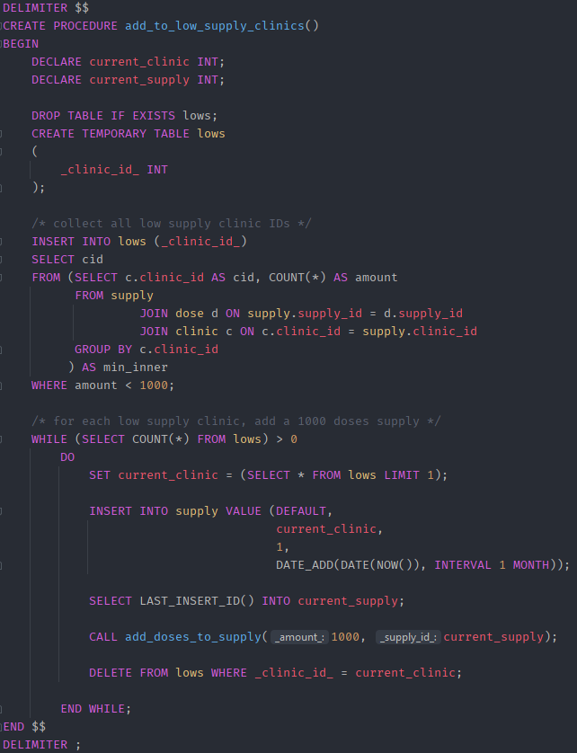


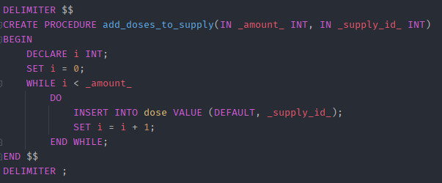
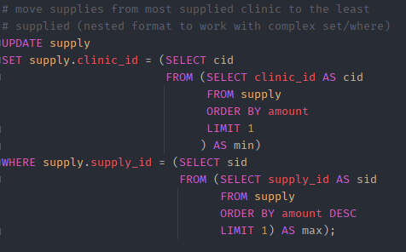
USERS
ENTITIES
ENTITIES
GENERAL
TABELS
S
ERD
TRIGGERS
QUERIES
The system has three front ends
One for citizens - to make appointments and track their status through an app and a website
Second for health care workers - to receive daily schedules
Third for city leaders / project managers - to overlook the operation and get relevant information to make informed logistical and managerial decisions.
Q
Vaccine (VaccineID, Name, Company)
Citizen (CitizenID, Fname, Lname, PhoneNum, RiskGroup, Age, Weight, Email, District)
HealthCareWorker (WorkerID, FirstName, LastName, PhoneNum, LicenseNum, Seniority)
Clinic (ClinicID, PhoneNum, Email, Street, HouseNum, District)
Inventory (InventoryID, VaccineID, Amount)
Appointment (AppointmentID, Date, ClinicID, WorkerID, Fullfield)
Vaccine (VaccineID, Name, Company)
Citizen (CitizenID, Fname, Lname, PhoneNum, RiskGroup, Age, Weight, Email, District)
HealthCareWorker (WorkerID, FirstName, LastName, PhoneNum, LicenseNum, Seniority)
Clinic (ClinicID, PhoneNum, Email, Street, HouseNum, District)
Inventory (InventoryID, VaccineID, Amount)
Appointment (AppointmentID, Date, ClinicID, WorkerID, Fullfield)
select queries
The system oversees a vaccination operation in a city, managing data about its citizens, medical workers, and clinics and their vaccine inventories.
The purpose of the system is to facilitate vaccination appointments for citizens of varying risk groups, track the vaccination phase for each citizen, and make sure each clinic is adequately staffed and has enough vaccines in its inventory.
The system has a front end for users to make appointments and track their status through an app and a website, and one for city leaders / project managers to overlook the operation and get relevant information to make informed logistical and managerial decisions.
select queries
Update/insert/delete
Update/insert/delete
select queries
Update/insert/delete
TR
T
E
R
D
E
E
U
U
G
G

Slide 14
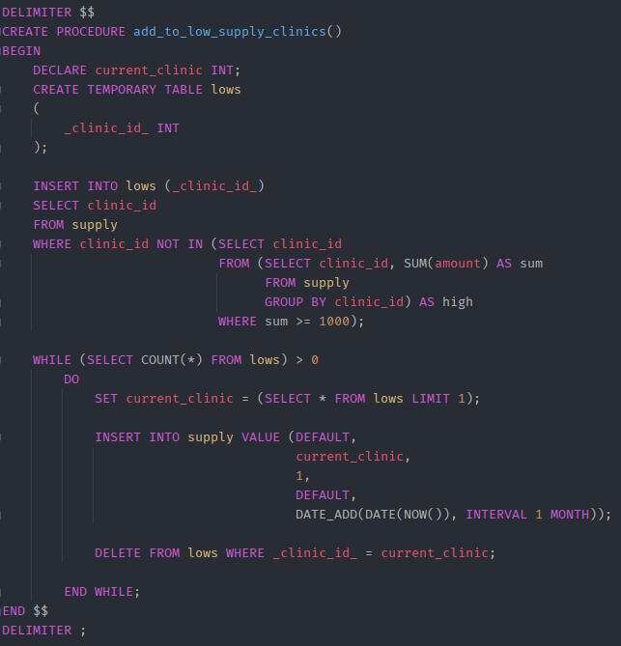

USERS
ENTITIES
ENTITIES
GENERAL
TABELS
ERD
S
TRIGGERS
QUERIES
SECURITY
The system has three front ends
One for citizens - to make appointments and track their status through an app and a website
Second for health care workers - to receive daily schedules
Third for city leaders / project managers - to overlook the operation and get relevant information to make informed logistical and managerial decisions.
Q
Vaccine (VaccineID, Name, Company)
Citizen (CitizenID, Fname, Lname, PhoneNum, RiskGroup, Age, Weight, Email, District)
HealthCareWorker (WorkerID, FirstName, LastName, PhoneNum, LicenseNum, Seniority)
Clinic (ClinicID, PhoneNum, Email, Street, HouseNum, District)
Inventory (InventoryID, VaccineID, Amount)
Appointment (AppointmentID, Date, ClinicID, WorkerID, Fullfield)
Vaccine (VaccineID, Name, Company)
Citizen (CitizenID, Fname, Lname, PhoneNum, RiskGroup, Age, Weight, Email, District)
HealthCareWorker (WorkerID, FirstName, LastName, PhoneNum, LicenseNum, Seniority)
Clinic (ClinicID, PhoneNum, Email, Street, HouseNum, District)
Inventory (InventoryID, VaccineID, Amount)
Appointment (AppointmentID, Date, ClinicID, WorkerID, Fullfield)
select queries
The system oversees a vaccination operation in a city, managing data about its citizens, medical workers, and clinics and their vaccine inventories.
The purpose of the system is to facilitate vaccination appointments for citizens of varying risk groups, track the vaccination phase for each citizen, and make sure each clinic is adequately staffed and has enough vaccines in its inventory.
The system has a front end for users to make appointments and track their status through an app and a website, and one for city leaders / project managers to overlook the operation and get relevant information to make informed logistical and managerial decisions.
select queries
Update/insert/delete
Update/insert/delete
Update/insert/delete
select queries
TR
The server will direct different users to the database based on permission level:
The operation manager will have access to everything.
District managers only to the parts relating to their districts.
Citizens only have access to make and see their appointments, and status.
Health care workers can access everything relating to their work schedule and appointments/patients.
T
E
R
D
E
E
U
U
G
G

Slide 15
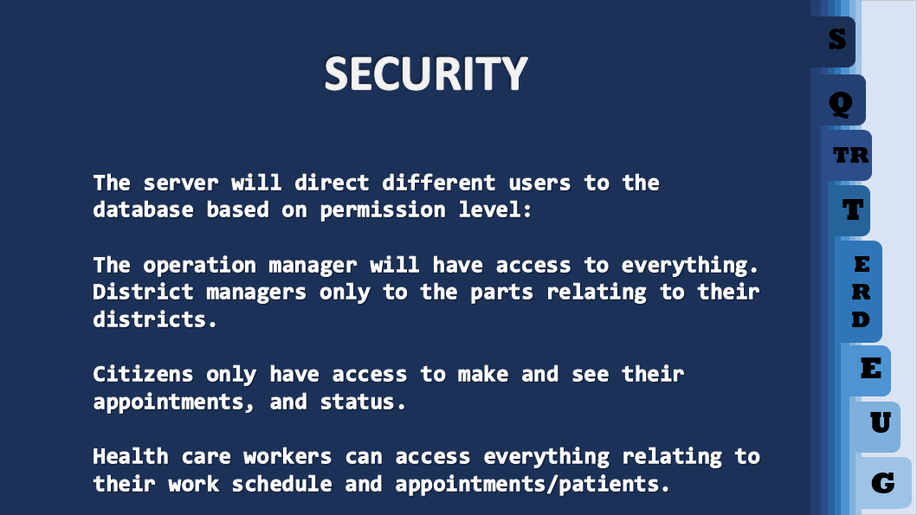
THANKS FOR YOUR ATTENTION ☺

